Slide 1
Data Structures
COURSE CODE: CS-201
TOPIC: ARRAYS
COURSE INSTRUCTOR: RIDA ZAHRA

Slide 2
Goals for today
To study:
  Introduction to Arrays
  Types of Array
  Linear Array
  Length of Array

Slide 3
CLO Covered
CLO1: Explain the fundamentals of data structure as well as algorithms that operate on them
CLO2: Apply and design various data structures methods for specified applications.

Slide 4
Introduction to Array
An array is a collection of items of the same variable type that are stored at contiguous memory locations.
It is one of the most popular and simple data structures used in programming.

Slide 5
Arrays
What is an array?
A linear structure approach (sequential memory location).
A useful way of collecting the similar type of data items.
Example:
In case of Employee Record:
Declare 50 different variables to store the age of employees.
Assign values to each variable.
It is not easy to handle these variables in the program
The concept of array is useful in this situation
Note: Arrays can also be termed as Linear Arrays

Slide 6
Basic terminologies of Array
Array Element: Elements are items stored in an array.
Array Index: Elements are accessed by their indexes. Indexes in most of the programming languages start from 0.

Slide 7
Linear Arrays
A linear array is a list of a finite number of n homogeneous data elements ( that is data elements of the same type) such that
  The elements of the arrays are referenced respectively by an index set consisting of n consecutive numbers
  The elements of the arrays are stored respectively in successive memory locations

Slide 8
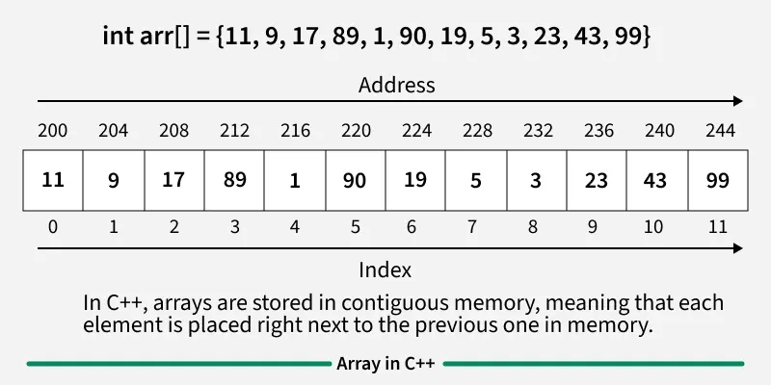
Memory representation of Array
In an array, all the elements or their references are stored in contiguous memory locations. This allows for efficient access and manipulation of elements.

Slide 9
Declaration of Array
Arrays can be declared in various ways in different languages.
// This array will store integer type element
int arr[5];
// This array will store char type element
char arr[10];
// This array will store float type element
float arr[20];

Slide 10
Initialization of Array
Arrays can be initialized in different ways in different languages.
int arr[] = { 1, 2, 3, 4, 5 };
char arr[5] = { 'a', 'b', 'c', 'd', 'e' };
float arr[10] = { 1.4, 2.0, 24, 5.0, 0.0 };

Slide 11
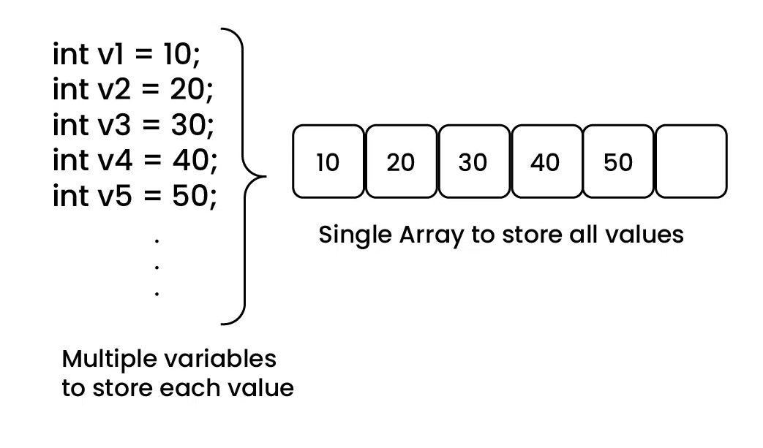
Why do we Need Arrays?
Assume there is a class of five students and if we have to keep records of their marks in examination then, we can do this by declaring five variables individual and keeping track of records but what if the number of students becomes very large, it would be challenging to manipulate and maintain the data. So we use an array of students.

Slide 12
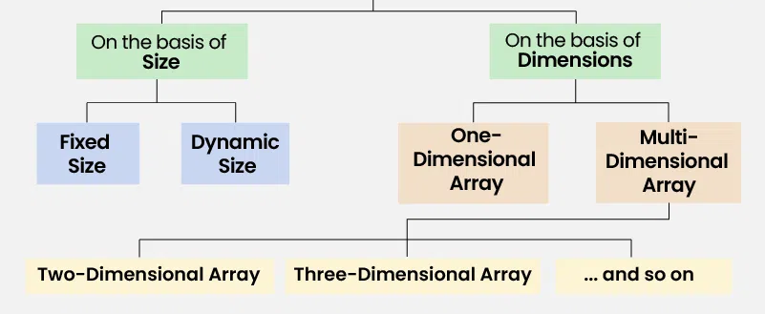
Types of Arrays
Arrays can be classified in two ways:
On the basis of Size
On the basis of Dimensions

Slide 13
Types of Arrays on the basis of Size
1. Fixed Sized Arrays
We cannot alter or update the size of this array. Here only a fixed size (i,e. the size that is mentioned in square brackets []) of memory will be allocated for storage.
In case, we don't know the size of the array then if we declare a larger size and store a lesser number of elements, it will result in a wastage of memory. And if we declare a lesser size than the number of elements then we won't get enough memory to store all the elements.

Slide 14
Examples
// Here the memory is allocated at compile time.
int arr1[5];
// Another way (creation and initialization both)
int arr2[5] = {1, 2, 3, 4, 5};

Slide 15
2. Dynamic Sized Arrays
The size of the array changes as per user requirements during execution of code so the coders do not have to worry about sizes. They can add and removed the elements as per the need. The memory is mostly dynamically allocated and de-allocated in these arrays.
The size of the array changes as per user requirements during execution of code so the coders do not have to worry about sizes. They can add and removed the elements as per the need. The memory is mostly dynamically allocated and de-allocated in these arrays.

Slide 16
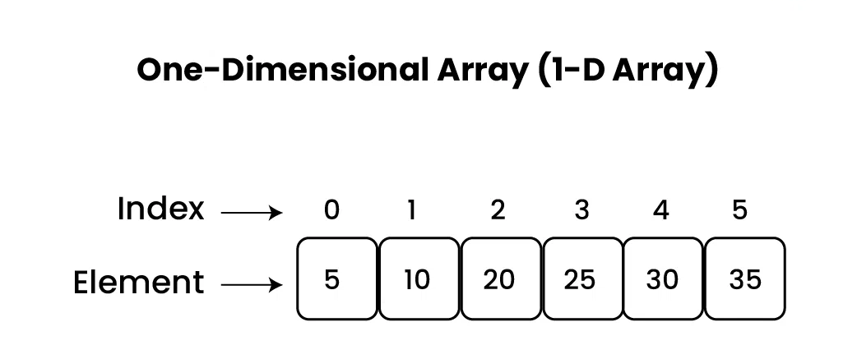
Types of Arrays on the basis of Dimensions
1. One-dimensional Array(1-D Array): You can imagine a 1d array as a row, where elements are stored one after another.

Slide 17
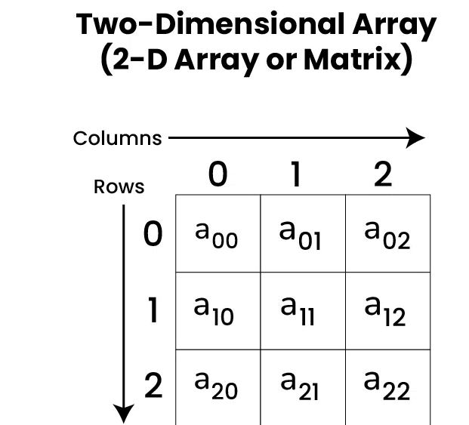
2. Multi-dimensional Array:
A multi-dimensional array is an array with more than one dimension. We can use multidimensional array to store complex data in the form of tables, etc. We can have 2-D arrays, 3-D arrays, 4-D arrays and so on.
Two-Dimensional Array(2-D Array or Matrix): 2-D Multidimensional arrays can be considered as an array of arrays or as a matrix consisting of rows and columns.

Slide 18
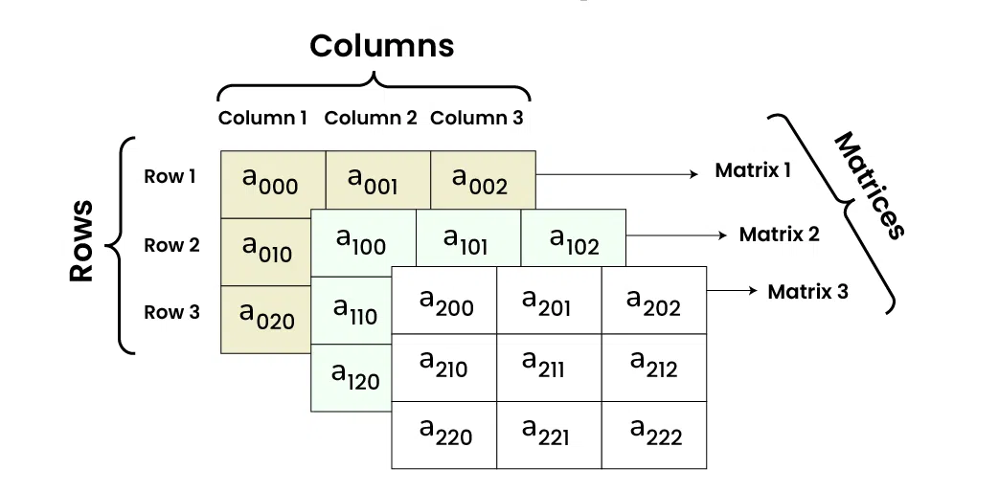
Three-Dimensional Array(3-D Array): A 3-D Multidimensional array contains three dimensions, so it can be considered an array of two-dimensional arrays.

Slide 19
What will be the output?
int main() {
int arr[5] = {2, 4, 8, 12, 16};
cout << arr[2] << " ";
cout << arr[4] << " ";
cout << arr[0] << " ";
return 0;
}

Slide 20
Linear Arrays
The number n of elements is called the length or size of the array.
The index set consists of the integer 1, 2, … n/ 0,1,….n-1
Length or the number of data elements of the array can be obtained from the index set by:
Length = UB – LB + 1
where UB is the largest index called the upper bound and LB is the smallest index called the lower bound of the arrays

Slide 21
Linear Arrays
Element of an array A may be denoted by
  Subscript notation A₁, A₂, , …. , A_{n}
  Parenthesis notation A(1), A(2), …. , A(n)
  Bracket notation A[1], A[2], ….. , A[n]
Usually used the subscription notation or the bracket notation.
The number K in A[K] is called subscript or an index and A[K] is called a subscripted variable

Slide 22
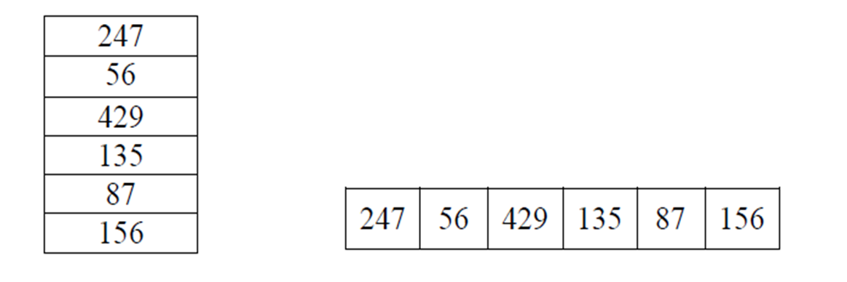
Linear Array
Array DATA be a 6-element linear array of integers such that DATA[0]=247, DATA[1]=56, DATA[2]=429, DATA[3]=135, DATA[4]=87, DATA[5]=156..

Slide 23
Example
An automobile company uses an array AUTO to record the number of auto-mobiles sold each year from 1932 through 1984. Rather than beginning the index set with 1, it is more useful to begin the index set with 1932 so that AUTO[K] = number of automobiles sold in the year K. Find the total number of elements in the array.
LB= 1932
UB = 1984
Length = UB – LB + 1 = 1984 – 1932 + 1 = 53
That is, AUTO contains 53 elements, and its index set contains of all integers from 1932 through 1984.

Slide 24
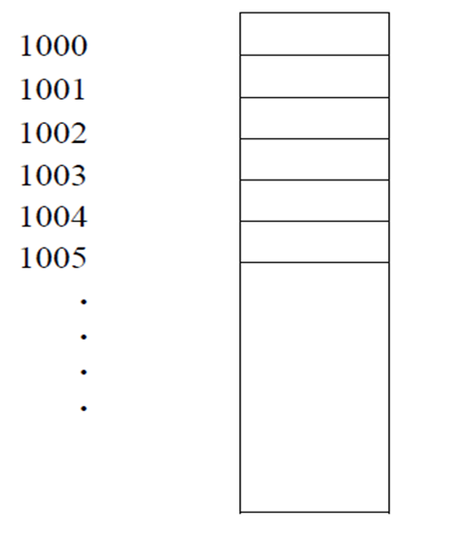
Representation of Linear Array in Memory
Let LA be a linear array in the memory of the computer
LOC(LA[K]) = address of the element LA[K] of the array LA
The element of LA are stored in the successive memory cells
Computer does not need to keep track of the address of every element of LA, but need to track only the address of the first element of the array denoted by Base(LA) called the base address of LA
LOC(LA[K]) = Base(LA) + w(K – lower bound) where w is the number of words per memory cell of the array LA [w is a size of the data type]
Computer Memory

Slide 25
Representation of Linear Array in Memory
Consider the example array AUTO, which records the number of automobiles sold each year from 1932 through 1984. Array AUTO appears in memory is pictured in Fig. 01 (next slide) . Assume, Base(AUTO) = 200 and w = 4 words per memory cell for AUTO.
Then the base addresses of following arrays are,
LOC(AUTO[1932]) = 200, LOC(AUTO[1933]) = 204, LOC(AUTO[1934]) = 208, …….

Slide 26
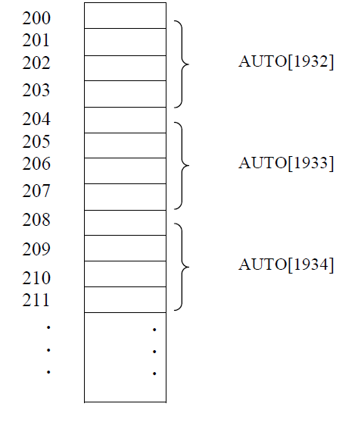
Representation of Linear Array in Memory
Let we find the address of the array element for the year K = 1965. It can be obtained by using Equation:
LOC(AUTO[1965]) = Base(AUTO) + w(1965 – lower bound) = 200 + 4(1965-1932) = 332

Slide 27
Example
200
201
202
203
204
205
206
207
LA[1]
Find the address for LA[6]
Each element of the array occupy 1 byte
LA[2]
LA[3]
LA[4]
LA[5]
LA[6]
LA[7]
LA[8]
:
LOC(LA[K]) = Base(LA) + w(K – lower bound)
LOC(LA[6]) = 200 + 1(6 – 1) = 205

Slide 28
Example 2
200
201
202
203
204
205
206
207
Find the address for LA[16]
Each element of the array occupy 2 byte
LA[1]
LA[2]
LA[3]
LA[4]
:
LOC(LA[K]) = Base(LA) + w(K – lower bound)
LOC(LA[16]) = 200 + 2(16 – 1) = 230

Slide 29
Task
Given the base address of an array A[1300…………1900] as 1020 and the size of each element is 2 bytes in the memory, find the address of A[1700]?

Slide 30
task
Given the base address of an array B[500…1000] as 2040, and each element occupies 4 bytes in memory, find the address of B[750].

Slide 31
Data Structures
COURSE CODE: CS-201
TOPIC: ARRAYS
COURSE INSTRUCTOR: RIDA ZAHRA

Slide 32
Today’s Goal
Operations on Array

Slide 33
CLO Covered in this Lecture
CLO2: Apply and design various data structures methods for specified applications.

Slide 34
Operations on Linear Array
We can perform various operations on a linear array:
Traversing- processing each element of the array list.
Inserting- adding new elements in the array list.
Deleting- removing an element from the array list.
Sorting- arranging the elements of the list in some sorting order.
Merging- combining the elements of two array lists in a single array list.

Slide 35
Overflow & Underflow
Overflow: Attempt to insert an element into an array exceeding its size limit.
Underflow: Attempt to delete or traverse an element from an empty array.

Slide 36
Traversal in Array
Traversal in an array refers to the process of accessing each element in the array sequentially, typically to perform a specific operation, such as searching, sorting, or modifying the elements.
Traversing an array is essential for a wide range of tasks in programming, and the most common methods of traversal include iterating through the array using loops like for, while, or foreach. Efficient traversal plays a critical role in algorithms that require scanning or manipulating data.

Slide 37
Traversing Linear Arrays
Traversing is accessing and processing (visiting ) each element of the data structure exactly ones
Linear Array
•••

Slide 38
Traversing Linear Arrays
Traversing is accessing and processing (visiting ) each element of the data structure exactly ones
Linear Array
•••

Slide 39
Traversing Linear Arrays
Traversing is accessing and processing (visiting ) each element of the data structure exactly ones
Linear Array
•••

Slide 40
Traversing Linear Arrays
Traversing is accessing and processing (visiting ) each element of the data structure exactly ones
Linear Array
•••

Slide 41
Traversing Linear Arrays
Traversing is accessing and processing (visiting ) each element of the data structure exactly ones
Linear Array
•••

Slide 42
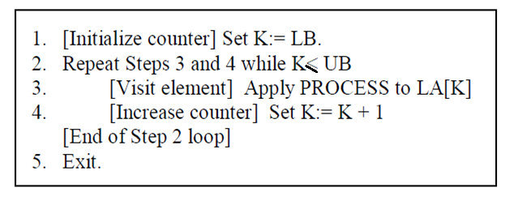
Traversing Algorithm
We can process each element of an array with the help of an index set.
Consider a Linear Array(LA) list given with lower bound(LB) and upper bound(UB) that contains 'n' number of elements. We can traverse the list with the given algorithm.

Slide 43
Searching in Linear Arrays
Search ‘4’ in the following linear array:
10 | 3 | 5 | 9 | 4 | 8 | 1 | 2

Slide 44


Slide 45
Examples:
Input: arr[] = [10, 20, 30, 40, 50]
Output: "10 20 30 40 50 "
Explanation: Just traverse and print the numbers.
Input: arr[] = [7, 8, 9, 1, 2]
Output: "7 8 9 1 2 "
Explanation: Just traverse and print the numbers.
Input: arr[] = [100, 200, 300, 400, 500]
Output: "100 200 300 400 500 "
Explanation: Just traverse and print the numbers.

Slide 46
Applications of Array Traversal
Array traversal plays a key role in many operations where we need to access or modify the elements of an array. Two of the most common applications are searching elements and modifying elements.
1. Searching Elements
Traversal is often used to search for an element in an array. By visiting each element of the array sequentially, we can compare each element with the target value to determine if it exists.
Example: If you have an array of numbers, and you need to find if a specific number is present in the array, array traversal would involve checking each element one by one until a match is found or the entire array has been searched.

Slide 47
2. Modifying Elements
Array traversal is also used to modify the elements of the array. This could involve updating values, changing the order, or applying some mathematical operations to each element. For example, you can multiply every element of an array by a constant, or increase each value by 1.
Example: If you want to increase each element in an array by 5, array traversal allows you to visit each element and modify it.

Slide 48
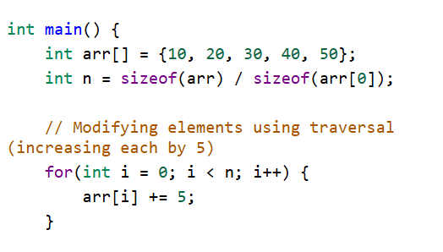
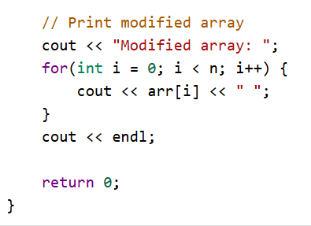

Slide 49
Traversing Linear Arrays
Traversing is accessing and processing (visiting ) each element of the data structure exactly ones
Linear Array
•••

Slide 50
Types of Searching in Arrays
Linear Search
Binary Search (can only be applied on sorted array)

Slide 51
Linear / Sequential Search
Sequential search is also known as linear or serial search. It follows the following step to search a value in array.
  Visit the first element of array and compare its value with required value.
  If the value of array matches with the desired value, the search is complete.
  If the value of array does not match, move to next element and repeat same process up till to the length of array until the desired element is found.

Slide 52
Linear Search Algorithm
1. Start
2. Set i = 0
3. Repeat steps 4 & 5 while i < UB
4. IF (item==LA[i]) THEN GOTO Step 6
5. Set i = i + 1
6. Print ‘record found at index i’
7. Print ‘item not found’
8. Stop

Slide 53
Time Complexity
Running time for Linear Search is O(n) as it depends on input size.

Slide 54
Binary Search
Binary search is a quicker method of searching for value in the array. But binary search is applied only on sorted array.
It locates the middle element of array and compare with desired number.
If they are equal, search is successful and the index of middle element is returned.
If they are not equal, it reduces the search to half of the array.
If the search number is less than the middle element, it searches the first half of array.
Otherwise it searches the second half of the array. The process continues until the required number is found or loop completes without successful search.

Slide 55
Binary Search Algorithm
if UB== -1, then print ‘underflow’ & return.
Repeat while (LB<=UB)
{
mid=(LB+UB)/2;
if (LA[mid]==item)
print ‘item found’; return LA[mid];
elseif (item<LA[mid])
UB=mid-1;
else
LB=mid + 1;
}
print ‘item not in list’;

Slide 56
Time Complexity
Running time for Binary Search is O(log n) as it divides the array in two half if required element is not found

Slide 57

Questions?

